Slide 1


Carey Carrey:
Minghao Du, Yujie Hu, Zhao Su, Zihan Wang, Hanrui Zhong
03/08/2021

Slide 2



Introduction
Problem
Improvement
Patients: filled surveys manually
Patients: filled surveys online
Doctors: review surveys & compose reports manually
Pros:
Highly customized survey
Higher readability & data management efficiency
Cons:
doctors still need to manually compose the medical reports
Large amount of repetitive work
Chaotic survey management
Inefficient time utilization
Notes:
The problem we would like to address in this project originates from the healthcare industry.
In the past, the method that surgeons used to manage their patient data is reviewing the survey result manually filled by the patient and then manually generate corresponding medical reports. The report should provide a complete and accurate description of the patient's medical history, from which they can know medical conditions, diagnoses, the care and treatment provided and the results of such treatments. Obviously, composing such reports is very time-consuming.
Therefore, Dr. Hornyak from Hartford Healthcare presented us this business opportunity to enhance the efficiency of generating medical reports.
Luckily, there are some solutions in the industry existing. Now, the patient can take the survey on an online platform, which allows the doctor to manage the patient data more efficiently since the survey is highly customized and the readability of the survey results has been improved a lot. However, the doctors still need to manually compose the medical reports.

Slide 3



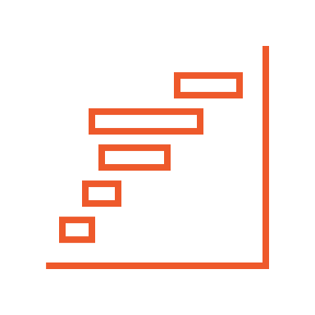
Opportunity-NLG Module
Patients: fill survey online
NLG: generate reports automatically
Keep and extract patients' records from the platform
Doctors: analyze
Notes:
We believe, for the next stage, developing an NLG (natural language generation) module would be a good choice. So, in this project, we leverage the power of AI to generate the medical reports automatically. In this case, the doctors will be able to keep and extract patients' records from the platform and spend less time in reports composing.

Slide 4
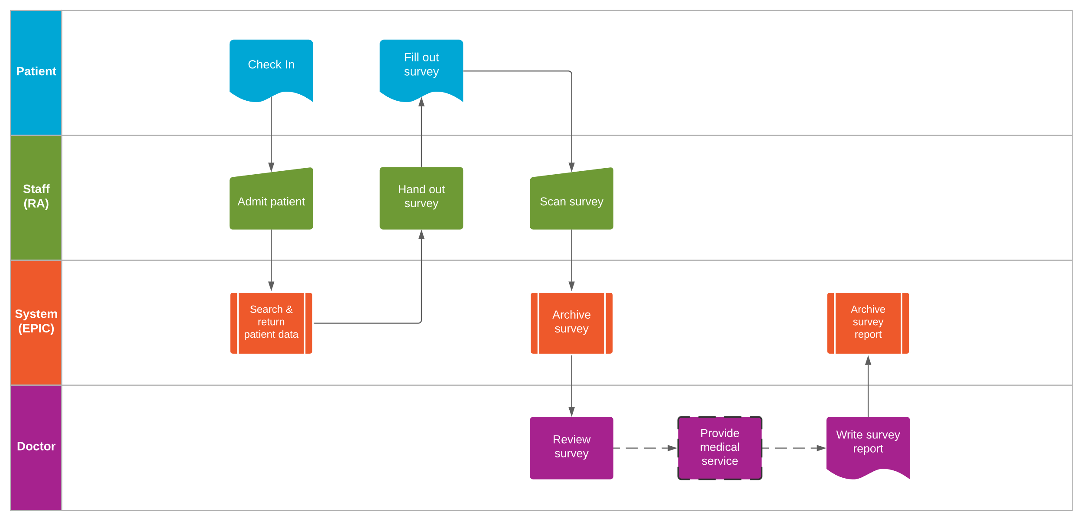
Data Collection
Notes:
Here is how the data is collected from our client’s hospital
As shown in the slide, a patient starts with checking in with a staff
The staff will then try to find that patient’s information in their current system
For both new and returning patient, the staff will hand out a corresponding survey for them to fill out. This survey was pre-created by the doctors to understand patients’ symptoms. This is the survey question for our dataset.
Other than typical medical information like records of family diseases, and allergies, the majority of the survey is focusing on collecting patient’s subjective accession about their condition like pain levels what will make the pain better or worse, usually using numbers to represent the pain levels. This is survey answers for our dataset.
Once the survey is finished, the staff will scan the survey and store it in the system so that the doctor will proceed to provide medical services based on the survey.
The final step of this process is for the doctor to write a descriptive style report based on the patient’s survey result. This will be our final part of dataset.

Slide 5
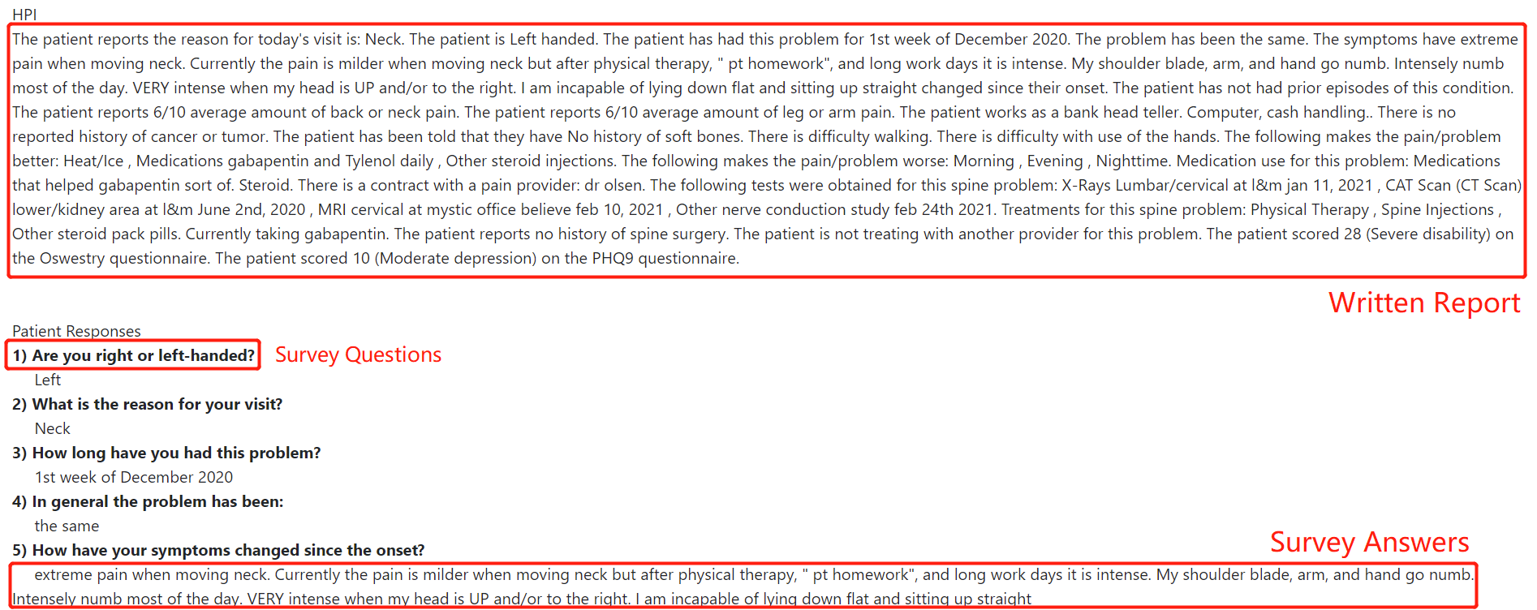
Data Description
Data is unique and real, and belongs to text data
We have more than 140 sets of data, around 314347 characters
Dataset helps doctors understand the recovery of patients and provide the record for insurance company
Automation saves costs​, lightens the workload​, and avoids errors and track every single detail.
Notes:
Our data has several properties.
First, it is unique since it is created by real patient answers and doctor writings. All the data are descriptive data represented in words or numbers.
Second, we have more than 140 sets of data, which is around 314347 characters as our training inputs.
Third, data is stored in doctor’s personal portfolio, the storage is shown as the pictures. We get the access from doctors to check these medical records.
Next, our dataset actually helps our doctors understand the recovery of a patient. For example, since the survey questions will frequently ask subject questions like pain levels represented in numbers. If a returning patient’s number of pain levels falls, the treatment is proved as effective. Also, the reports are regarded as the evidences to show the insurance company that the patients are well cured.
Finally, the automate generation of the reports will save time a large amount of time for doctors to finish repetitive works. It also avoids errors and missing details when writing a report.

Slide 6



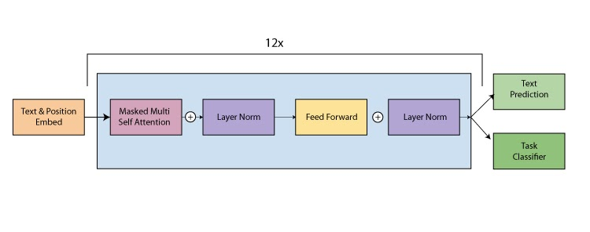
Approaches
Reference: What is a transformer
OpenAI's GPT-2
Models
Input
Output
Select the Best Model
TensorFlow RNN—baseline model
Generative Pre-trained Transformer-2 (GPT-2)
GPT-2 （Fine tuning)
Survey Questions and responses
Summary
Report
GPT-2
Advantages of GPT-2
Models can be finetuned
High accuracy
Small dataset
GPT-2 Architecture
Notes:
Considering our input is survey questions and responses and output is summary report, we chose two possible models TensorFlow RNN and GPT-2. And we will evaluate the performance of those model and choose the best one. RNN is our baseline model.
GPT-2 was released by the researchers of OpenAI on 2019. It can predict the new text even a whole article or story only with the few sentences or words. ‘Pre-Trained’ in the name suggests the huge number of parameters over which this model is trained. Transformer in the name suggests it used the transformer architecture, which is an architecture for transforming one sequence into another one with the help of Encoder and Decoder. GPT-2 is a transformer decoder model.
GPT-2 has many benefits so we select is as our model
Models can be finetuned with smaller datasets. So we will also adjust the parameters of GPT-2 later to get a better result
Smaller datasets are capable of generating such impressive results,
Research shows it has an very high accuracy
Source:
https://medium.com/inside-machine-learning/what-is-a-transformer-d07dd1fbec04
https://www.analyticssteps.com/blogs/openais-gpt-2-generative-pre-trained-transformer-2-ai-that-is-too-dangerous-to-handle

Slide 7

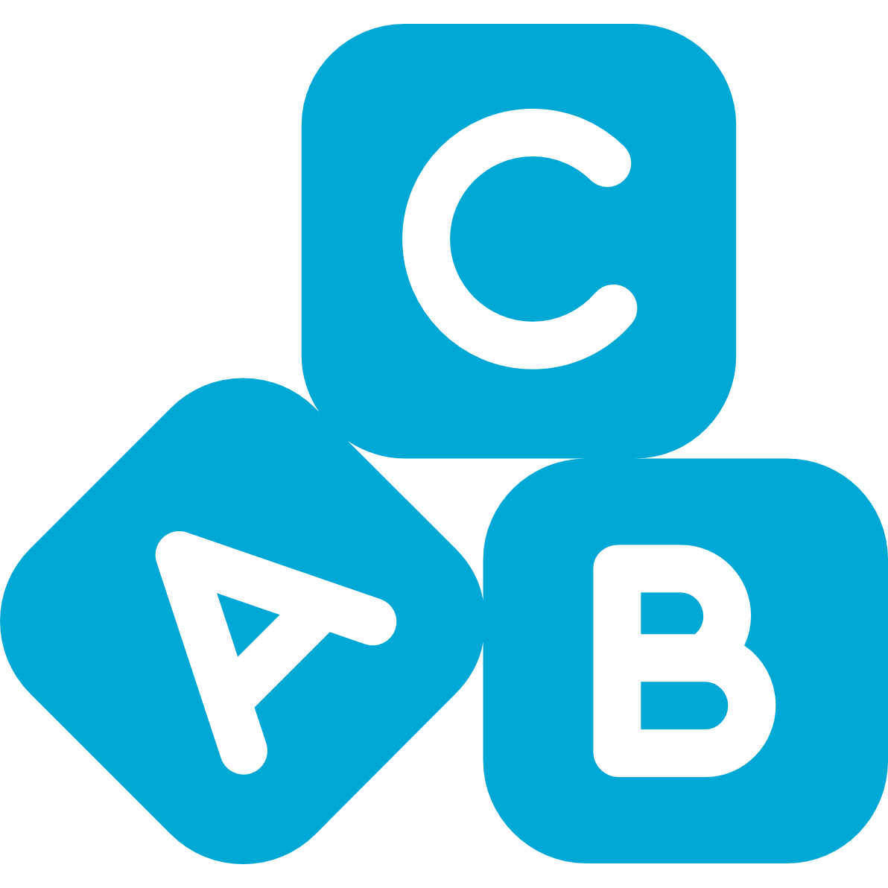
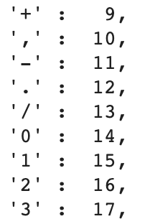

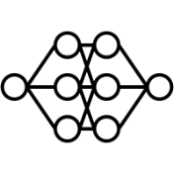

TensorFlow RNN
Reference: Text generation with an rnn : Tensorflow core; Examining the Transformer architecture
Results
Vectorize the text
Clearly, the result of the model is not good. We can’t even get a meaningful word.
Reasons
Build the model
The reason for the result comes from the major shortcoming of RNN: failure to remember long-range dependencies.
RNNs need to encode the information from the entire sequence in one single context vector, which means its tokenization is based on individual letters but not a word. As the gap between 2 words grows, the RNN seems to “forget” the previous words.
Next Char Predictions: 'JU\'Ab(@?cNUa—G43:0EqONP3l0(Vs!OhheKNOQ:—j3zN?Ag;N+x(!5—Nwc’K?vp,LixjceGn,NN"yId84FkgCw3pwRWdxU?E06H"'
The untrained model
The average amount of back or neck pain. 10 is the worse pain and 0 is no pain at all.
3/10
7) Do you have any of the following problems?
Bladder incontinence, Joint pain
The trained model
(epoch = 2000)
Solution
GPT-2
Notes:
Source Code: https://colab.research.google.com/gist/DMinghao/17ac9bd6e28a1617742a594a42fedbd4/gpt-2-text-generating-model.ipynb

Slide 8
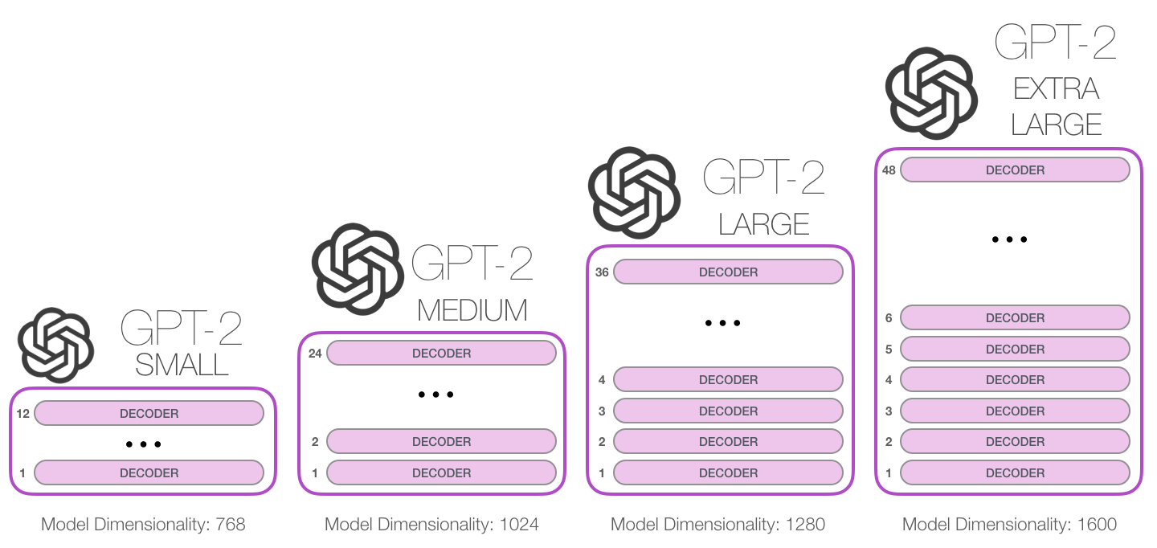
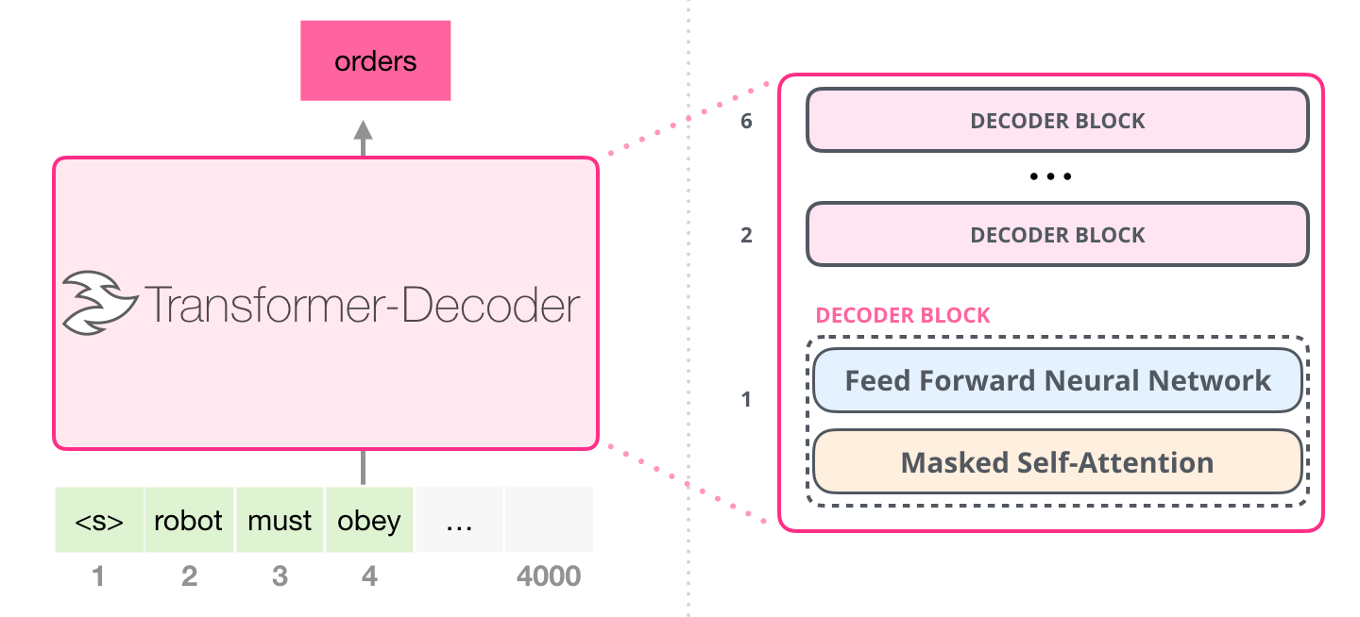


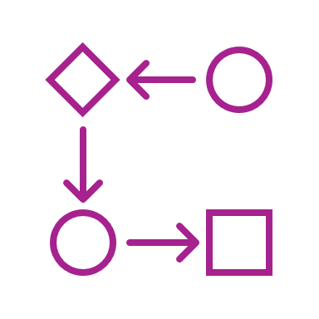
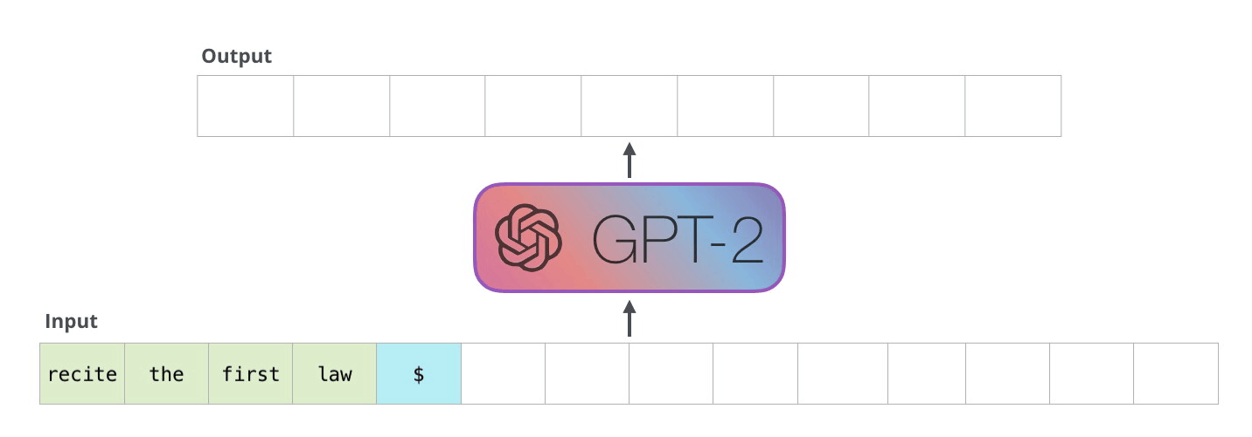
GPT-2 (Raw)​
Reference: radford2019language
Test Prompt
1) What is the reason for your visit today?
Review my MRI scan from 11/10
2) Are you RIGHT or LEFT handed?
Right
3) When did this problem start?
A few years ago
…
9) Do you have a personal history of cancer or tumors?
No
…
17) Over the last two weeks how often have you been bothered by any of the following problems?
Score: 10
Select
Model
Build
Peripherals
Prompt for
Response
GPT-2's Response
...
Have you been injured that you could attribute to scratching or video game.
Yes to all of the above.
...
Notes:
Source Code: https://colab.research.google.com/gist/DMinghao/17ac9bd6e28a1617742a594a42fedbd4/gpt-2-text-generating-model.ipynb
GPT-2 is the predecessor of GPT-3, it is a pre-trained state-of-the-art natural language processing AI. It’s constructed with multiple layers of Transformer Decoders; these decoders are extremely good at doing sequence-to-sequence transduction task. With stacking these decoders together and feeding it a massive amount of data, 8 million web pages to be precise, GPT-2 demonstrated an exceptional talent in writing human like text.
To leverage the power of GPT-2, the first step of instantiating the model, is to select one of the four processing cores of which are different in number of decoders. Smaller cores might provide better performance in training and production environments. Whereas larger cores not only could generalize better than smaller ones, but also has more “knowledge” in imitating doctor’s writing style.

Slide 9
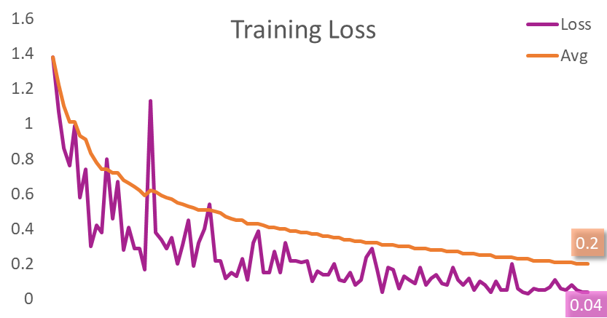
GPT-2 (Fine tunned)​
Reference: radford2019language
Training Parameters
2000 epochs
1e-5 learning rate
77225 tokens
Outcome Evaluation
Outputted result is satisfactory but not optimal
Future improvements could apply for better results
Doctor's Summary
GPT-2's Summary
Test Prompt
Mr. x is a # y.o. male who presents for follow up with his MRI scan from last visit. A few years ago, the patient was involved in a car accident and had minor brain damage. The patient reports no personal history of tumors or cancer. The patient reports that he is experiencing Nausea, Back pain, Neck pain, and Joint pain, and the pain hasn't changed from last visit. Based on the PHQ9 survey, the patient might be experiencing moderate depression.
The patient reports the reason for today's visit is: Review my MRI scan from 11/10. The patient reports that they are Right handed. The problem started A few years ago. The patient reports the problem has not happened in the past. The problem started I was injured in a car accident . Workup has included: MRI Brain, Neurology Assoc.. The patient reports a personal history of cancer or tumor. Previous treatment for patient's reported cancer/tumor history includes No answer. Patient scored 10 (Moderate depression) on PHQ9 Survey.
17) Over the last two weeks how often have you been bothered by any of the following problems?
Score: 10
Notes:
Source Code: https://colab.research.google.com/gist/DMinghao/17ac9bd6e28a1617742a594a42fedbd4/gpt-2-text-generating-model.ipynb

Slide 10
Conclusion
Result compare
Doctor’s Summary
Next Char Predictions: 'JU\'Ab(@?cNUa—G43:0EqONP3l0(Vs!OhheKNOQ:—j3zN?Ag;N+x(!5—Nwc’K?vp,LixjceGn,NN"yId84FkgCw3pwRWdxU?E06H"'
After 2000 epochs
The average amount of back or neck pain. 10 is the worse pain and 0 is no pain at all.
3/10
7) Do you have any of the following problems?
Bladder incontinence, Joint pain
Mr. x is a # y.o. male who presents for follow up with his MRI scan from last visit. A few years ago, the patient was involved in a car accident and had minor brain damage. The patient reports no personal history of tumors or cancer. The patient reports that he is experiencing Nausea, Back pain, Neck pain, and Joint pain, and the pain hasn't changed from last visit. Based on the PHQ9 survey, the patient might be experiencing moderate depression.
TF RNN
…
The patient reports the problem has not happened in the past. The problem started I was injured in a car accident . Workup has included: MRI Brain, Neurology Assoc.. The patient reports a personal history of cancer or tumor.
…
...
Have you been injured that you could attribute to scratching or video game.
Yes to all of the above.
...
After 2000 epochs
GPT-2
Business Value
Future Improvements
A similarity between the original reports and the derivative reports.
A possibility of expansion to apply to more hospitals to generate survey reports.
A connection to hospital system and insurance company system
Collect more data for model fine tuning
Compare more state-of-the-art models to obtain better result
Use reinforced learning to fine tune models with human preferences
Notes:
The result shows a similarity between the original reports and the derivative reports. Such similarity shows a possibility that we can expand such methods to more hospitals to help neurologist generate reports. The further application could be that the generated report can be connected to current hospital system and insurance company system so that the medical records could be saved by these institutions.

Slide 11

Thank You
Contact us for project detail:
Zihan Wang: zwang207@jhu.edu
Minghao Du: mdu5@jhu.edu
Yujie Hu: yhu74@jhu.edu
Zhao Su: zsu13@jhu.edu
Hanrui Zhong: hzhong12@jhu.edu

Slide 12
References
Maxime. (2020, March 05). What is a transformer? Retrieved March 07, 2021, from https://medium.com/inside-machine-learning/what-is-a-transformer-d07dd1fbec04
Balodi, T. (n.d.). OpenAI's GPT-2 (GENERATIVE Pre-Trained Transformer-2) : "AI that is too dangerous To Handle": Analytics steps. Retrieved March 07, 2021, from https://www.analyticssteps.com/blogs/openais-gpt-2-generative-pre-trained-transformer-2-ai-that-is-too-dangerous-to-handle
Text generation with an rnn : Tensorflow core. (n.d.). Retrieved March 07, 2021, from https://www.tensorflow.org/tutorials/text/text_generation
Montantes, J. (2019, June 27). Examining the Transformer architecture - Part 1: The Openai Gpt 2 CONTROVERSY. Retrieved March 07, 2021, from https://towardsdatascience.com/examining-the-transformer-architecture-part-1-the-openai-gpt-2-controversy-feceda4363bb
@article{radford2019language,
title={Language Models are Unsupervised Multitask Learners},
author={Radford, Alec and Wu, Jeff and Child, Rewon and Luan, David and Amodei, Dario and Sutskever, Ilya},
year={2019}
}

